Slide 1
A Brief Introduction to Beamforming
BRD Intern
Nana Chang
(張若暄)

Slide 2
What is Beamforming?
Microphone Array
BF Filter
Signal Enhancement
Outline
Model Description
Performance Measures
Common BF Methods Overview
Related Libraries Overview
Notes:
先做BF的定義：針對Microphone Array訊號的後處理，

Slide 3
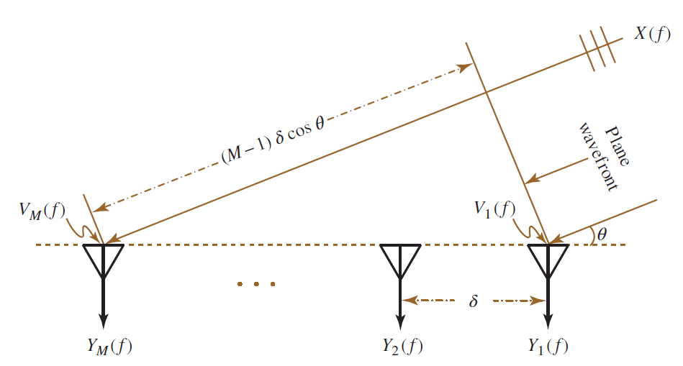
Model Description
Microphone Array with Known Location
Circular, Linear, random placement, etc.
X – Source Signal
Y – Received Signal
V – Noise

Slide 4
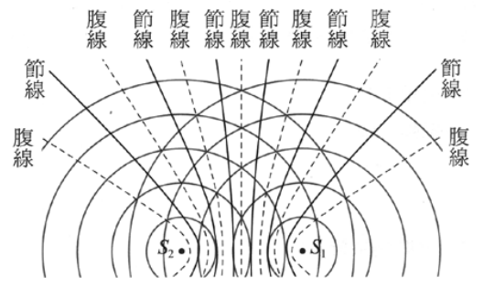
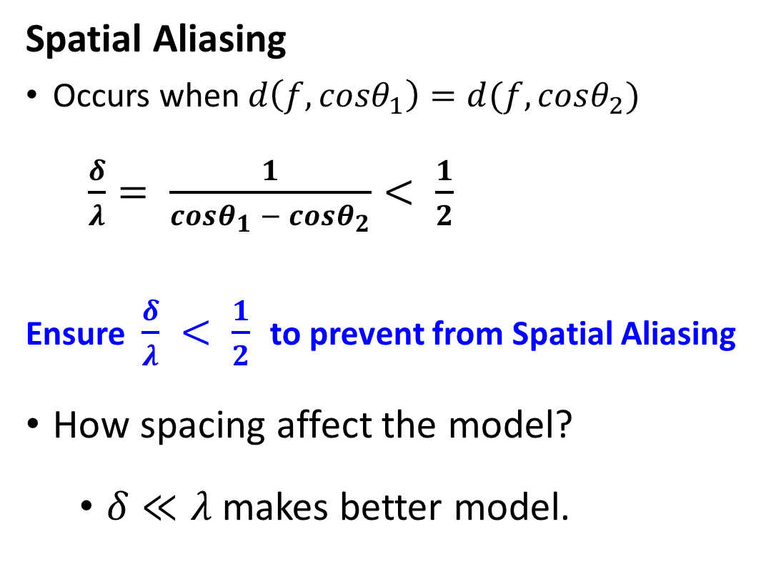
Model Description
Spatial Aliasing
Occurs when $d\left(f, cosθ_{1}\right)=d(f, cosθ_{2})$
$\frac{δ}{λ}= \frac{1}{cosθ_{1} − cosθ_{2}}< \frac{1}{2}$
Ensure $\frac{δ}{λ} < \frac{1}{2}$ to prevent from Spatial Aliasing
How spacing affect the model?
$δ≪λ$makes better model.
Notes:
提到球面波 -> 平行波
我想把Spatial Aliasing會發生的狀況用水波的干涉(腹線的產生條件)解釋所以貼一個水波圖

Slide 5
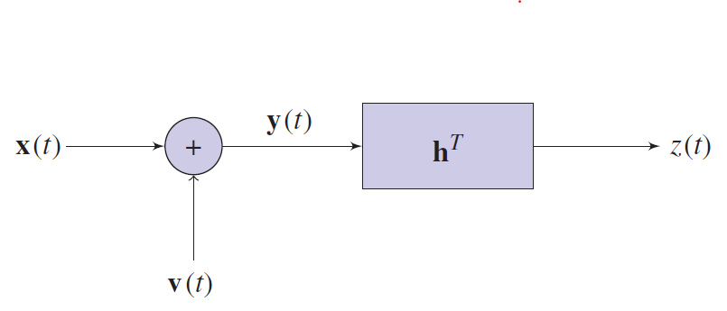
Model Description – Source of Noises
Self-noise from Circuit
usually white noise
Ambient Noise
Additive Noise: residual environment
Echoes: from speakers
Reverberation: reflected signal
Interference: multiple sources / speakers

Slide 6

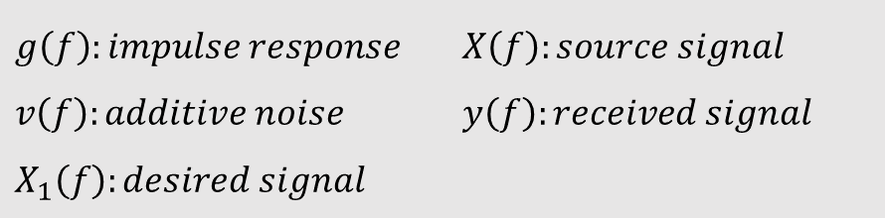
Model Description
d(f): Steering Vector
$y\left(f\right)=g\left(f\right)X\left(f\right)+v\left(f\right)$
$=d\left(f\right)X_{1}\left(f\right)+v\left(f\right)$
Related Paper: Three-Dimensional Acoustic Source Mapping with Different Beamforming Steering Vector Formulations (May 2012)
$g\left(f\right):impulse response$ $X\left(f\right):source signal$
$v\left(f\right):additive noise$ $y\left(f\right):received signal$
$$X_{1}\left(f\right):desired signal$$
Notes:
Steering: 操舵
Steering Vector的角色在於定義Source Signal和Desired Signal的關聯

Slide 7
Performance Measures
Signal Enhancement?
Improve performance measures (SNR, MSE, etc)
Improve hearable quality
Boost relevant information (DoA, BSS, etc)
Restore signal of interest
Amplify desired signal
Suppress interferences
Notes:
BSS: Blind Signal Seperation

Slide 8
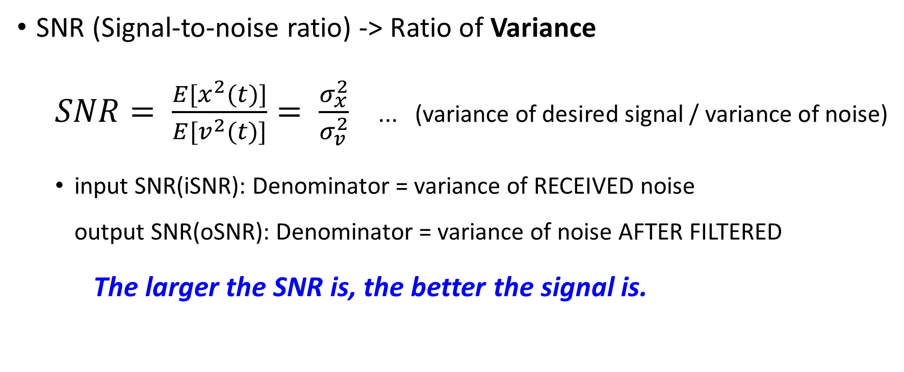
Performance Measures
SNR (Signal-to-noise ratio) -> Ratio of Variance
$SNR= \frac{E[x^{2}(t)]}{E[v^{2}(t)]}= \frac{σ_{x}^{2}}{σ_{v}^{2}}$ ... (variance of desired signal / variance of noise)
input SNR(iSNR): Denominator = variance of RECEIVED noise output SNR(oSNR): Denominator = variance of noise AFTER FILTERED
The larger the SNR is, the better the signal is.

Slide 9


Performance Measures
MSE (Mean-squared error)
$$J\left(h\right)=E\left[e^{2}\left(t\right)\right]=J_{d}\left(h\right)+J_{n}\left(h\right)$$
The smaller the MSE is, the better the signal is.
$$h:applied filter$$
$$e\left(t\right):error signal → e\left(t\right)=z\left(t\right)−x\left(t\right)$$
$J_{d}:$MSE of desired signal (desired signal distortion)
$$J_{n}:MSE of residual noise$$

Slide 10
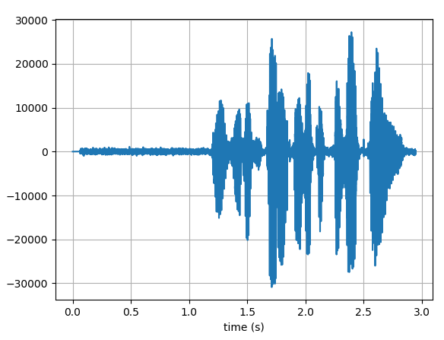

Performance Measures
Simulate model vs. Actual Signal Implementation
How to calculate when x(t) and v(t) are both unknown?
Sol.: take silent moment as reference.
Further info: “minimum statistics” by Rainer Martin
$$SNR= \frac{E[x^{2}(t)]}{E[v^{2}(t)]}$$

Slide 11
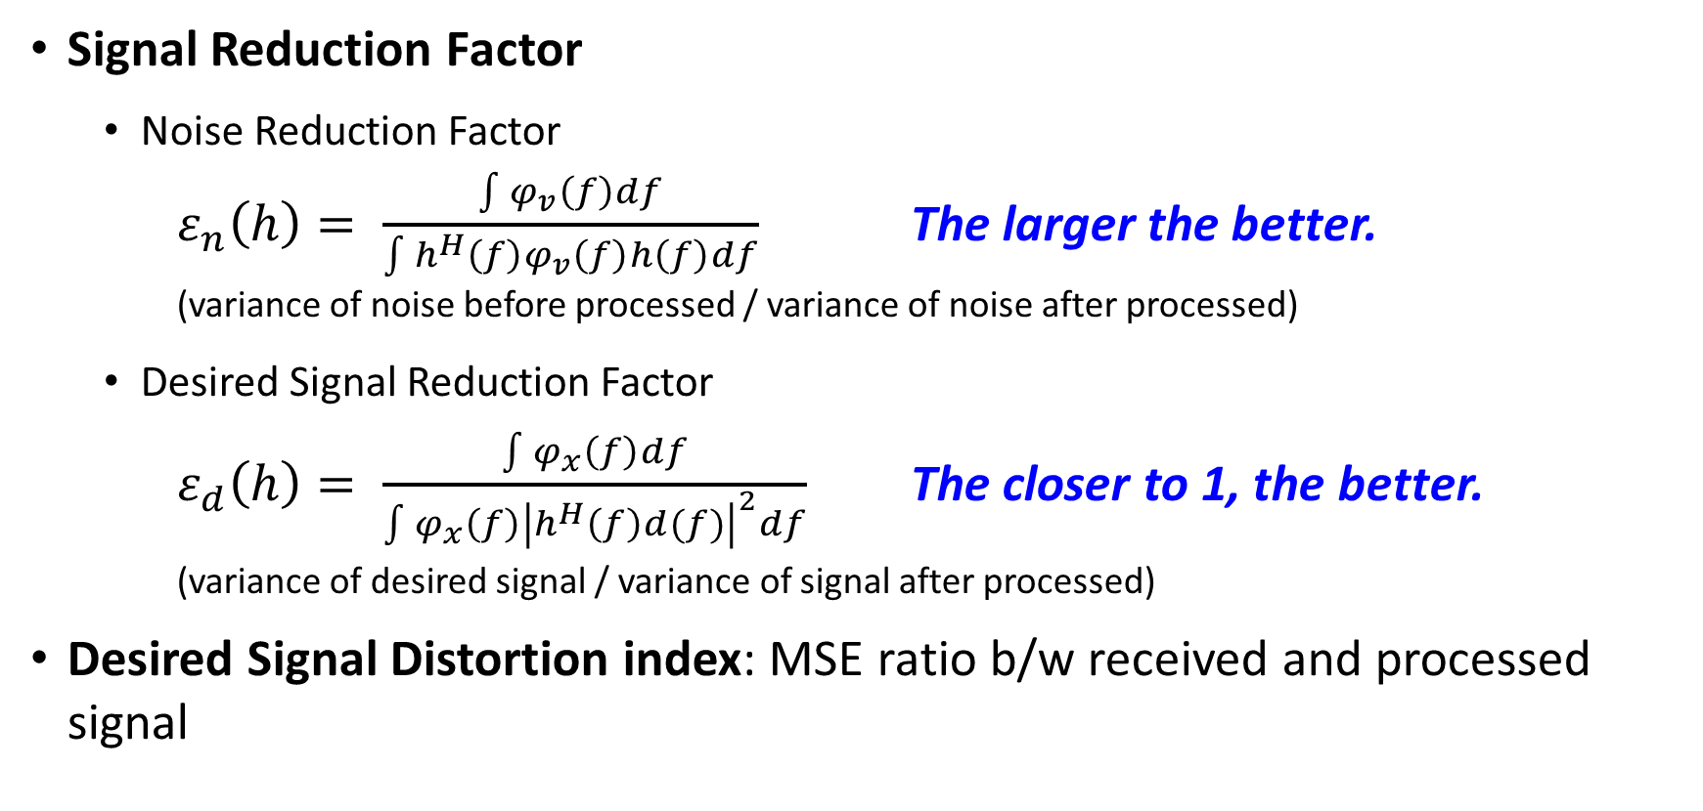
Performance Measures
Signal Reduction Factor
Noise Reduction Factor
$ε_{n}\left(h\right)= \frac{\int{φ_{v}\left(f\right)df}}{\int{h^{H}\left(f\right)φ_{v}\left(f\right)h\left(f\right)df}}$ The larger the better. (variance of noise before processed / variance of noise after processed)
Desired Signal Reduction Factor
$ε_{d}\left(h\right)= \frac{\int{φ_{x}\left(f\right)df}}{\int{φ_{x}\left(f\right){\left|h^{H}\left(f\right)d(f)\right|}^{2}df}}$ The closer to 1, the better. (variance of desired signal / variance of signal after processed)
Desired Signal Distortion index: MSE ratio b/w received and processed signal

Slide 12
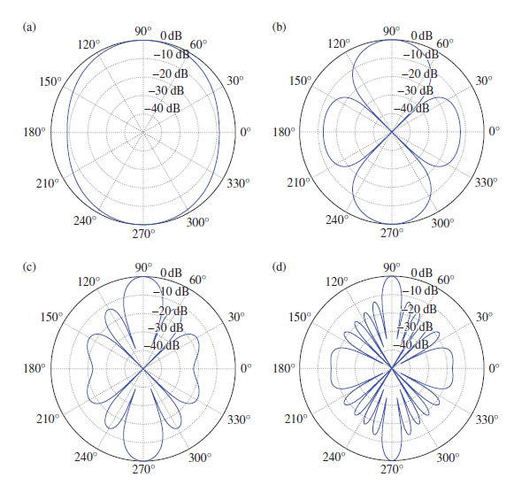
Performance Measures
Power / Polar Patterns
Parameters:
Beamformer Algorithms
BF Alg. parameters
Frequencies
# of microphones
Spacing b/w sensors

Slide 13
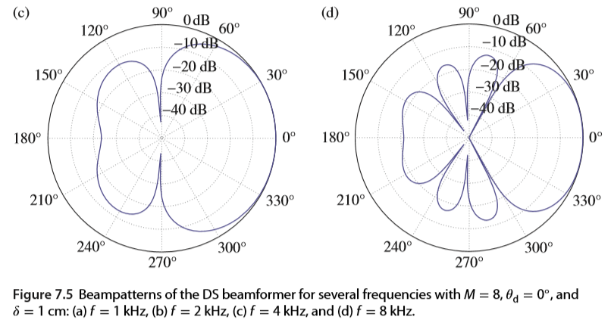
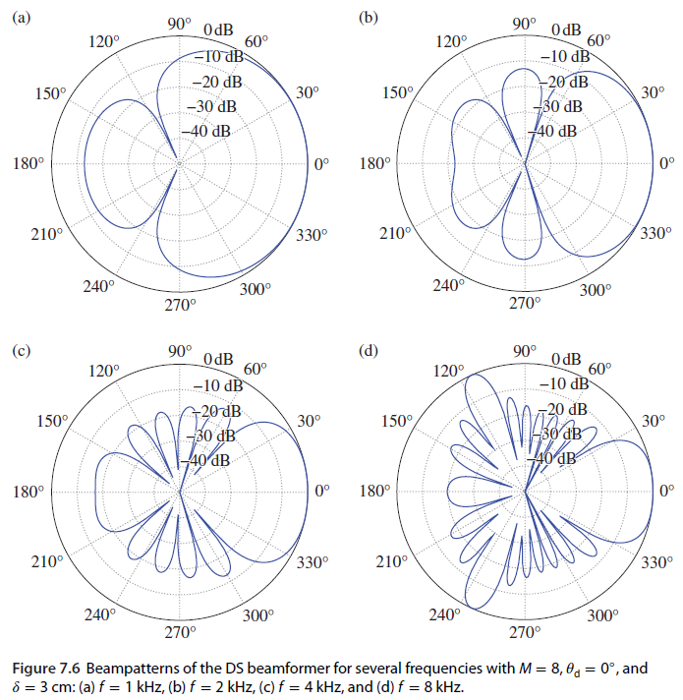
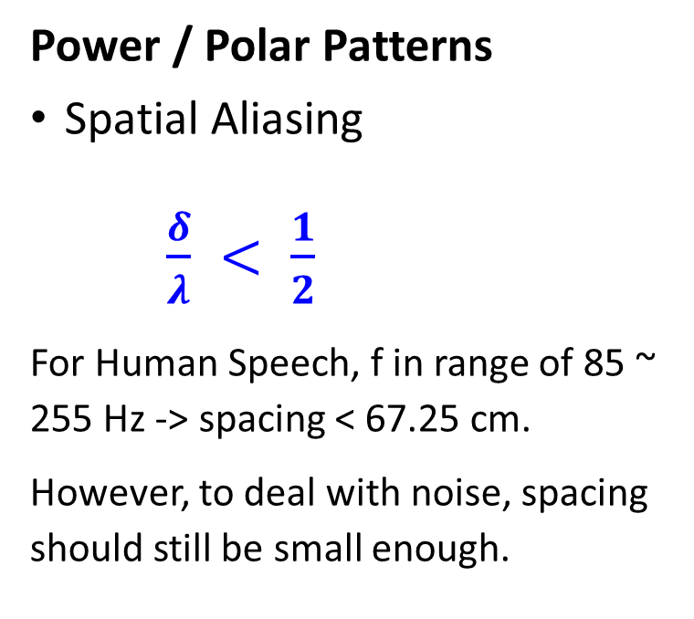
Performance Measures
Power / Polar Patterns
Spatial Aliasing
$\frac{δ}{λ} < \frac{1}{2}$
For Human Speech, f in range of 85 ~ 255 Hz -> spacing < 67.25 cm.
However, to deal with noise, spacing should still be small enough.

Slide 14

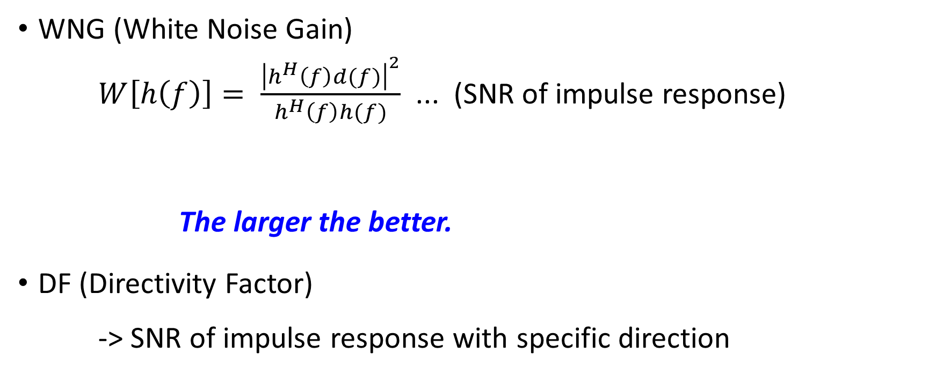
Performance Measures
WNG (White Noise Gain)
$W\left[h\left(f\right)\right]= \frac{{\left|h^{H}\left(f\right)d(f)\right|}^{2}}{h^{H}\left(f\right)h(f)}$ ... (SNR of impulse response)
The larger the better.
DF (Directivity Factor)
-> SNR of impulse response with specific direction
$$d\left(f\right):steering vector$$

Slide 15
Common BF Methods Overview
Purpose of BF
Spatial filtering – analyzation on multichannel signal
To form a main beam in the direction of the desired signal
To place nulls in the directions of interferences
Fixed Beamformer
Fixed coefficients
Adaptive Beamformer
Consider the statistics of the incoming data

Slide 16
Fixed Beamformer
Delay-and-sum (DS, DAS) | Maximizing WNG
Maximum DF | Maximizing DF
Superdirective | A particular case of Maximum DF BF -> take desired direction as 0 Lack robustness: Sensitive to white noise
Robust Superdirective | Enhanced Superdirective BF Compromise b/w supergain and white noise amplification
Notes:
Delay-and-sum (DS, DAS) -> maximizing the WNG
Maximum DF (Directivity Factor)

Slide 17
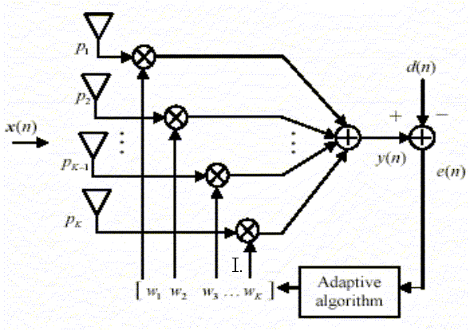
Adaptive Beamformers
Wiener | Minimizing MSE
MVDR | Minimizing MSE of the residual noise under distortionless constraint
Tradeoff | combination of Wiener and MVDR
Maximum Array Gain | Maximizing signal power
LCMV | Minimizing MSE with interference constraints
Notes:
Wiener -> minimizing narrowband MSE (J[h(f)])
MVDR -> minimizing narrowband MSE of the residual noise (J_{r}[h(f)]) under distortionless constraint
Tradeoff -> a compromise b/w noise reduction and desired signal distortion
Maximum Array Gain, LCMV

Slide 18
Common BF Methods Overview
Hardware Constraints
Cable transmission rate
Memory
Processor working speed

Slide 19
Related Libraries Overview
Acoular
Acoustic beamforming, Acoustic testing
Post-processing for multichannel data
Librosa
Music and Audio analysis
Beat, tempo, note, midi
Pyroomacoustics
Testing of audio array processing algorithms
2D/3D Room Acoustics Simulation
Algorithms: STFT, BF, DoA, Adaptive Filtering, BSS, etc

Slide 20
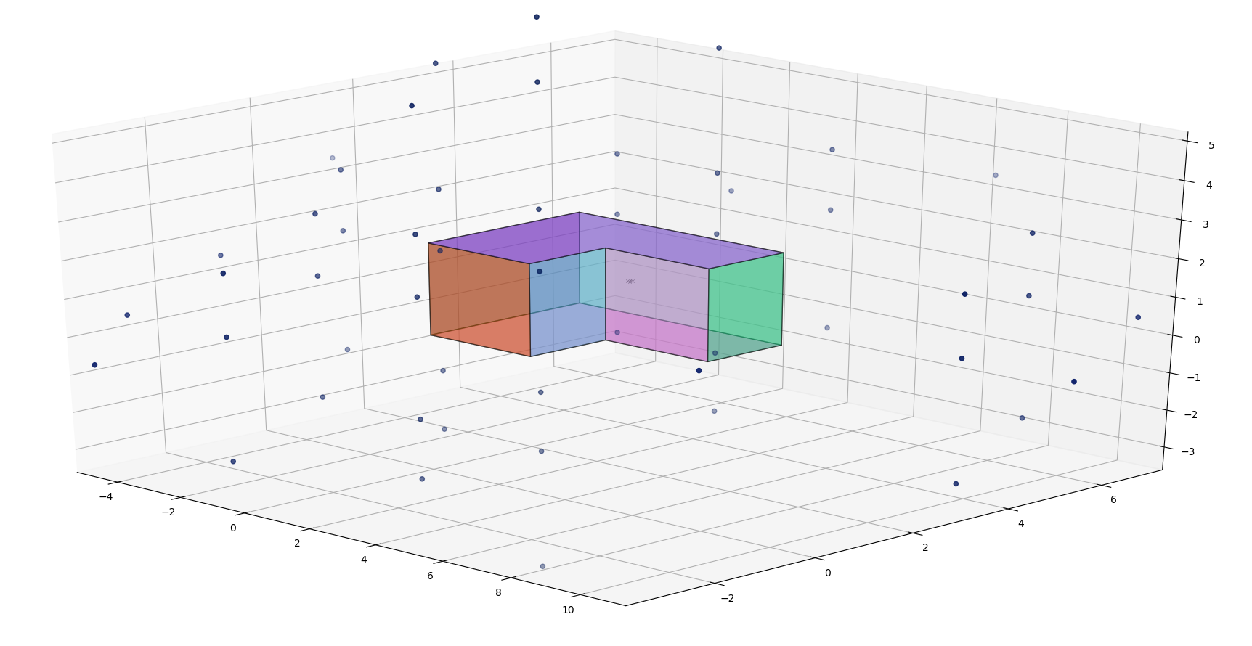
Pyroomacoustics Demo
Notes:
看可不可以直接放跑出來的model給大家看 (可以拉來拉去整個模型轉動比較清楚)

Slide 21
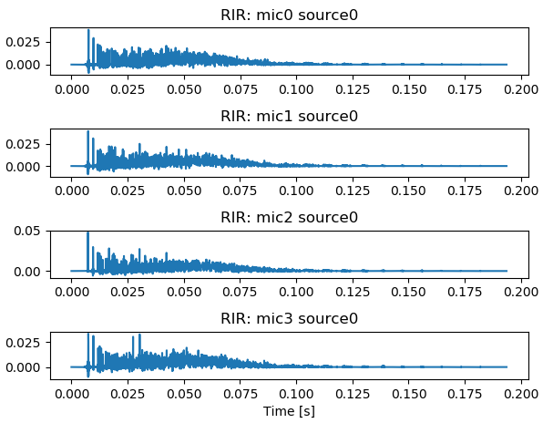
Pyroomacoustics Demo

Slide 22
QA

Slide 23
Performance Measures (這是草稿頁 之後拿掉!!)
SNR (Signal-to-noise ratio)
MSE (Mean squared error)
Reduction Factor
WNG (White noise)
這部分會描述SNR, MSE, Reduction Factor, WNG, DF等等的定義
(這些定義和各個BF有絕對的關係 所以特別討論)
(steering Vector和Spatial Aliasing應該也歸在這邊介紹)
我覺得最重要的 解釋Power Pattern的極座標圖(像這張)

